Slide 1

INSTITUTE : UIE
DEPARTMENT: ALL ACADEMIC UNITS
Bachelor of Engineering (All Sections)
Subject Name and Code:
Engineering Physics 23SPH-141
Prepared by: Deepak Kumar, Asso. Prof. Physics
FIBRE OPTICS
DISCOVER . LEARN . EMPOWER

Slide 2
Course Objectives
The course is designed to make the students industry ready to contribute in the growing demand of the industry at local, national and international level.
It will make the students competent to understand basic concepts and applications of advanced engineering physics and apply its principles in their respective fields at global platform.
It will enhance the skill level of the students and shall make them preferred choice for getting employment in industry and research labs.
It will give thorough knowledge of the discipline to enable students to disseminate knowledge in pursuing excellence in academic areas.

Slide 3
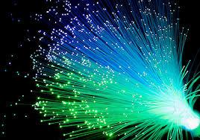
Course Outcomes
CO Number | Title On completion of this course, the students are expected to learn | Level
CO1 | Quote the basic fundamental concepts of lasers, optical fibres, crystallography, ultrasonic oscillations, semiconductor physics, quantum mechanics and nanotechnology. | Remember, Understand
CO2 | Demonstrate the working of various lasers, fibre components, semiconductor devices; explain the behaviour of crystalline solids, quantum and nano-scale systems. | Understand
CO3 | Solve problems by applying principles related to lasers, fibres, semiconductors, oscillations, quantum and nanoscience. | Applying
CO4 | Compare various lasers and fibres, semiconducting devices, crystalline materials, structures at quantum and nanoscale on the basis of their properties for industrial applications. | Analyze
CO5 | Develop various systems using lasers, fibres, semiconductors and nanomaterials for futuristic applications. | Design
Figure 2.1 Optical fibres [1]

Slide 4
Brief Flow of Presentation
Brief Introduction
Optical fiber construction
Critical angle & Total Internal Reflection
Acceptance angle & acceptance cone
Numerical Aperture
V-Number
Types of fibers
Dispersion & its types
Attenuation and Losses in Fiber
Advantages
Disadvantages
Applications
Figure 2.2 Basic structure and parts of optical fibre [2]

Slide 5
Definition of Optical fiber
An optical fiber is a flexible, transparent fiber made by glass (silica) or plastic to a diameter slightly thicker than that of a human hair.
Optical fiber is a dielectric waveguide and ideally has a cylindrical shape.
It consists of a core made up of a dielectric material which is surrounded by a cladding made up of a dielectric material of lower refractive index than core.

Slide 6
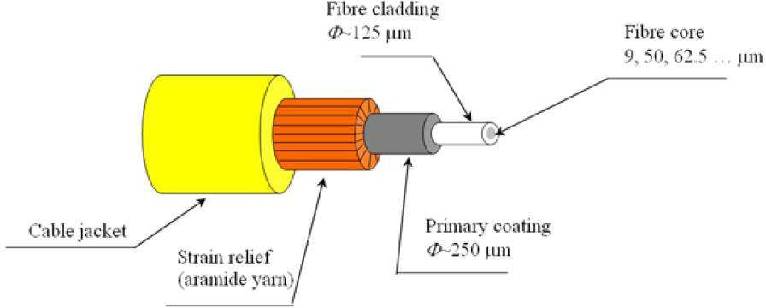
Parts of Optical Fiber
Core
Cladding
Buffering
Core having higher refractive index than cladding
Figure 2.3 Parts of optical fiber [3]

Slide 7
Core – thin glass center of the fiber where light travels.
Cladding– outer optical material surrounding the core.
Buffer Coating- plastic coating that
protects the fiber.

Slide 8
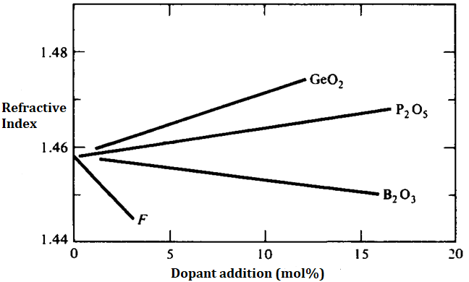
FIBER MANUFACTURE
I- Glass-Glass Fiber
Glass as silica (SiO₂) with refractive Index (RI) of 1.458 at 850nm
Addition of GeO₂ and P₂O₅ increases RI.
Addition of B₂O₃ and fluorine decreases RI.
Figure 2.4 Increase or decrease of RI by adding dopants [4].

Slide 9
FIBER MANUFACTURE
I- Glass-Glass Fiber
Combinations can be—
GeO₂ - SiO₂ core, SiO₂ Cladding.
P₂O₅ - SiO₂ core, SiO₂ Cladding.
SiO₂ core, B₂O₃ -SiO₂ Cladding.
GeO₂ - B₂O₃ - SiO₂ core, B₂O₃ -SiO₂ Cladding.
II- Plastic clad Glass Fiber
Glass core and plastic cladding.
Higher losses.
Short distance (several hundred meters).
Reduced cost.
Core Silicon resin RI = 1.405 at 850nm
Clad is Teflon PEP (Perfluoronated ethylene propylene) with RI = 1.338.
Large NA with large RI difference.
Core dia of 150 to 600µm.
LED as source.

Slide 10
FIBER MANUFACTURE
III- Plastic Fiber
Very short distance (100m max).
High attenuation.
Low cost, tough, durable, inexpensive.
Core dia of 110 to 1400µm.
LED as source.
Polystyrene core (1.6), methyl methacrylate clad (1.49). NA = 0.6.
Polymethyle methacrylate core(1.49), its co-polymer(1.40), NA = 0.5
Remember!
Germanium dioxide and phosphorus pentaoxide increase the refractive index of glass
Boron oxide decreases the refractive index of glass.
These oxides are known as dopants.
Changing composition of the mixture during the process influences refractive index profile of the preform

Slide 11
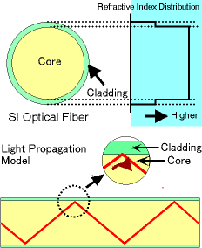
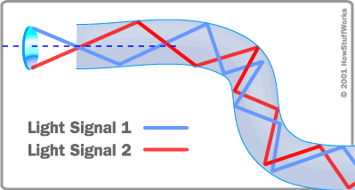
Transmission of Light Through Optical Fibers
Its total Internal Reflection
(a)
(b)
Figure 2.5 (a) & (b) Diagram of total internal reflection in different type of optical fiber [5].

Slide 12
Ray Theory Transmission
Refractive index
The index of refraction of a material is the ratio of the speed of light in a vacuum to the speed of light in the material
n = c/v
The factor n is the index of refraction (or refractive index) of
the medium.
For air and gases n ~ 1. At optic frequencies, the refractive index of water is 1.33.
Glass has many compositions, each with a slightly different
n. An approximate refractive index of 1.5 is representative for the silica glasses used in fibers; more precise values for these glasses lie between ~1.45 and ~1.48.

Slide 13

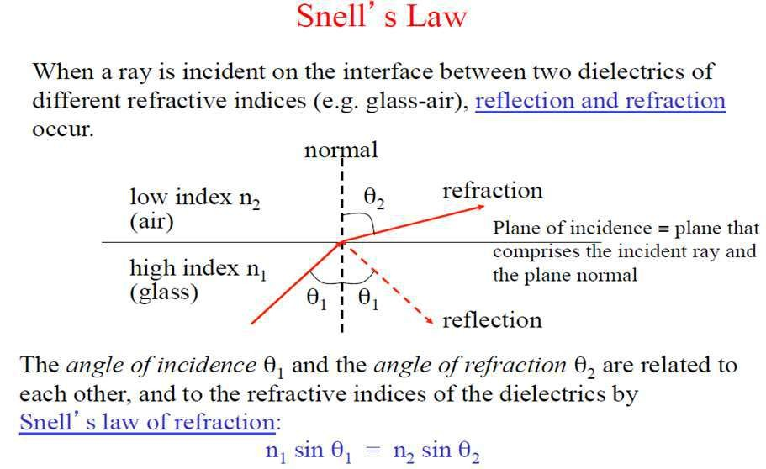
Ray Theory Transmission

Slide 14
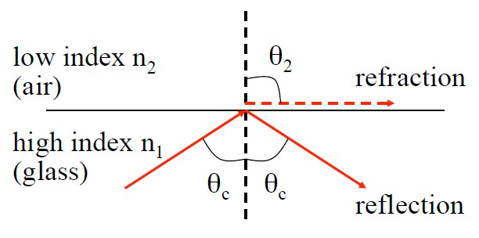
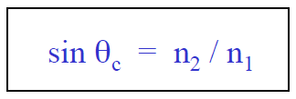

Critical Angle (θ_{c})
The angle at which total internal reflection occurs is called the critical angle of incidence.
At any angle of incidence (θ₁) greater than the critical angle, light is totally reflected back to the glass medium.
For n₁ > n₂, the angle of refraction θ₂ is always greater than the angle of incidence θ₁.
When the angle of refraction θ₂ is 90º the refracted ray emerges parallel to the interface between the media.

Slide 15
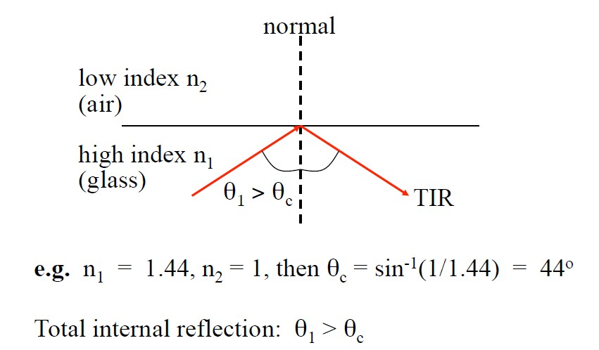
Total internal reflection
At angles of incidence θ₁ > θ_{c} the light is totally reflected back into the incidence higher refractive index medium. This is known as total internal reflection.

Slide 16
Refractive Index of Some Materials
Air -----------------------------------------------------------------------1.00
Water --------------------------------------------------------------------1.33
Magnesium fluoride --------------------------------------------------1.38
Fused silica (SiO₂)-----------------------------------------------------1.46
Sapphire (Al₂O₃)-------------------------------------------------------1.80
Lithium niobate (LiNbO₃)--------------------------------------------2.25
Indium phosphide (InP)----------------------------------------------3.21
Gallium arsenide (GaAs) ---------------------------------------------3.35
Silicon (Si)---------------------------------------------------------------3.48
Indium gallium arsenide phosphide (InGaAsP)-----------------3.51
Aluminum gallium arsenide (AlGaAs)-----------------------------3.60
Germanium (Ge) -------------------------------------------------------4.00
The index varies with a number of parameters, such as wavelength and temperature.

Slide 17
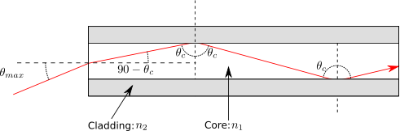
Acceptance angle and acceptance cone
Acceptance angle
It is the maximum angle of a ray (against the fiber axis) hitting the fiber core which allows the incident light to be guided by the core.
Acceptance angle
Figure 2.6 Acceptance angle of a typical step index fiber with a fiber core of refractive index n₁ [6]

Slide 18
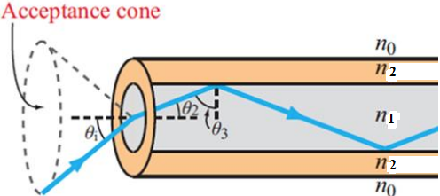
Acceptance cone
In fiber optics, the cone within which optical power may be coupled into the bound modes of an optical fiber. Here, the acceptance cone is derived by rotating the acceptance angle about the fiber axis.
Figure 2.7 Acceptance cone of an optical fiber [7]

Slide 19
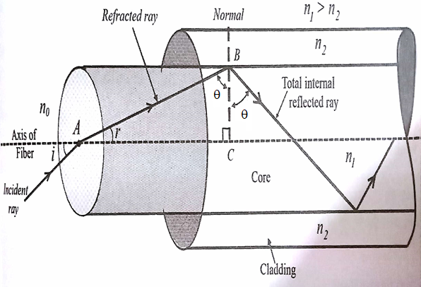
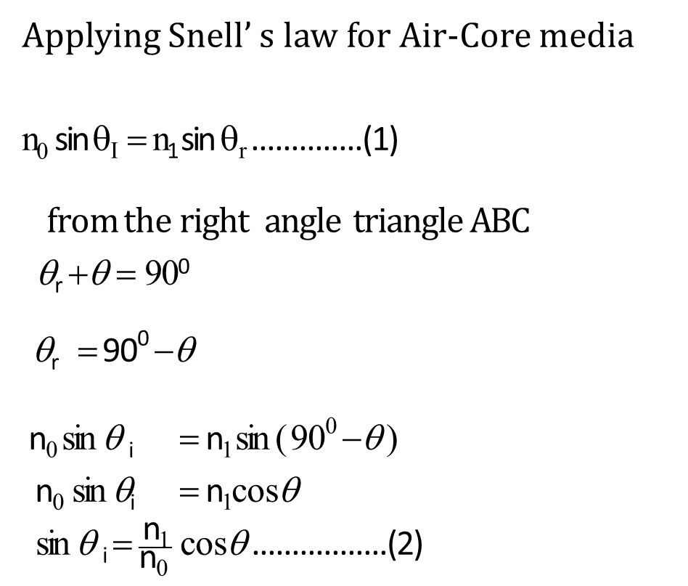
Expression of Acceptance angle
Applying Snell’ s law for Air-Core media
n₀ sin θ_{I} = n₁ sin θ_{r} ..............(1)
from the right angle triangle ABC
θ_{r} +θ = 90⁰
θ_{r} = 90⁰ −θ
n₀ sin θ _{i} = n₁ sin ( 90⁰ −θ )
n₀ sin θ_{i} = n₁cosθ
sin θ _{i} = $\frac{\text{n}\text{1}}{\text{n}\text{0} }$ cosθ .................(2)
Figure 2.8 Diagram of Acceptance angle [8]

Slide 20

when θ = critical angle (θ_{c} ) → θ_{i} = θ_{m}
sin θ_{m}= $\frac{\text{n}\text{1}}{\text{n}\text{0 }}$ cosθ _{c} …………………. (3)
according to law of refraction
n₁ sin i = n₂ sin r
here i = θ_{c} → r = 90
sinθ _{c} =$\frac{\text{n}\text{2}}{ \text{n}\text{1} }$ sin 90 =$\frac{\text{n}\text{2}}{\text{n}\text{1} }$
cos θ _{c} = $\sqrt{1−\sin^{2}}$θ = $\sqrt{1−\left(\frac{n_{2}}{n_{1}}\right)}$²

Slide 21

Cos θ _{c} =$\frac{\sqrt{n_{1}^{2} − n_{2}^{2}}}{n_{1}^{2}}$ ……………........... (4)
substitute equation (4) in (3)
sin θ_{m}= $\frac{\text{n}\text{1}}{\text{n}\text{0 }}$ $\frac{\sqrt{n_{1}^{2} − n_{2}^{2}}}{n_{1}^{2}}$
if the medium surrounding the fiber is air, then n₀ = 1
sin θ_{m}= $\sqrt{n_{1}^{2} −n_{2}^{2}}$
θ_{max} = sin$−1 \sqrt{n_{1}^{2} −n_{2}^{2}}$
Which is the required expression for maximum Acceptance Angle in optical fibers.

Slide 22
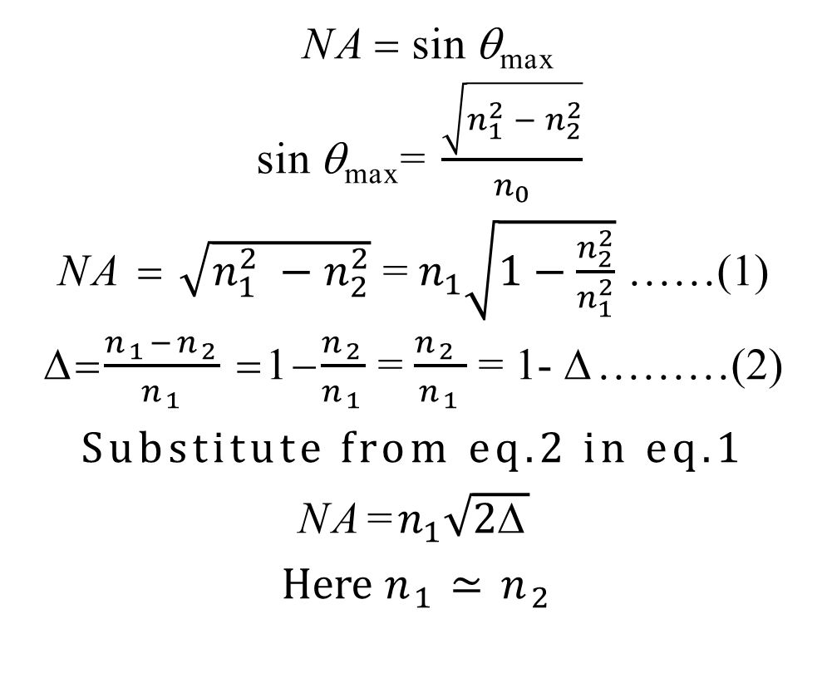
Expression of Numerical Aperture
NA = sin θ_{max}
sin θ_{max}= $\frac{\sqrt{n_{1}^{2} − n_{2}^{2}}}{n_{0}}$
NA = $\sqrt{n_{1}^{2} −n_{2}^{2}}$ = $n_{1}\sqrt{1−\frac{n_{2}^{2}}{n_{1}^{2}}}$ ……(1)
=$\frac{n_{1}−n_{2}}{n_{1}}$ =1−$\frac{n_{2}}{n_{1}}$ = $\frac{n_{2 }}{n_{1}}$ = 1- Δ………(2)
Substitute from eq.2 in eq.1
NA=$n_{1}\sqrt{2\text{Δ}}$
Here $n_{1}≃n_{2}$
Numerical Aperture
It defines gathering capability of fiber mathematically expressed as sine of acceptance angle.

Slide 23
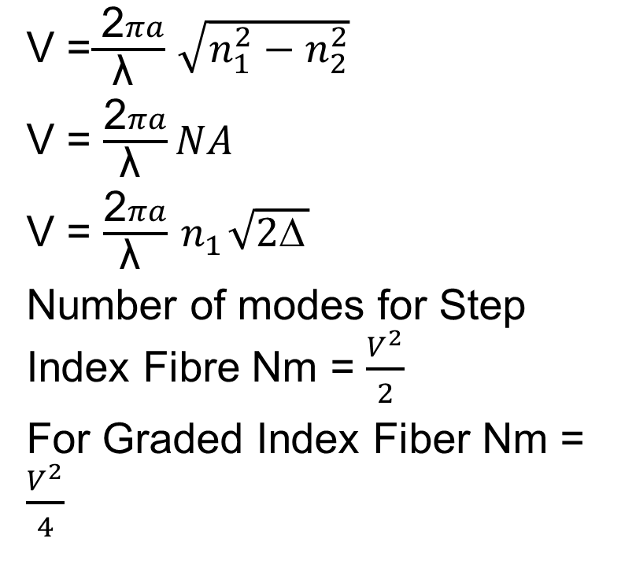
V-number or Normalized Frequency
V =$\frac{ \text{2}πa}{\text{λ} }$ $\sqrt{n_{1}^{2}−n_{2}^{2}}$
V = $\frac{\text{2}πa}{\text{λ} }NA$
V = $\frac{\text{2}πa}{\text{λ} }{ n}_{1}\sqrt{2\text{Δ}}$
Number of modes for Step Index Fibre Nm = $\frac{V^{2}}{2}$
For Graded Index Fiber Nm = $\frac{V^{2}}{4}$
No. of modes supported by optical fiber is obtained by cut-off condition known as normalized frequency or V-Number
V- number can be reduced either by reducing numerical aperture or by reducing diameter of fiber

Slide 24
Normalized frequency is a dimensionless parameter and simply called V-number or value of the fiber.
It combines in a very useful manner the information about three parameters, a, Δ and λ.
Limiting parameter for single and multimode propagation in optical fiber.
⇒ V ≤ 2.405 for Single Mode operation

Slide 25
Types of Optical fibers based on modes and refractive index
Mode is the one which describes the nature of propagation of electromagnetic waves in a wave guide.
It is the allowed direction whose associated angles satisfy the conditions for total internal reflection and constructive interference.
Based on the number of modes that propagates through the optical fiber, they are classified as:

Slide 26
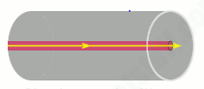
Single Mode fibers can propagate only the fundamental mode.
Multimode fibers can propagate hundreds of modes.
Single mode fibers:
In a fiber, if only one mode is transmitted through it, then it is said to be a single mode fiber.
A typical single mode fiber may have a core radius of 3 μm and a numerical aperture of 0.1 at a wavelength of 0.8 μm.
Figure 2.9 Single mode fiber [8]

Slide 27
Advantages of Single Mode Fiber
Only one path is available.
Core diameter is small
No dispersion
Higher band width (1000 MHz)
Used for long haul communication
Fabrication is difficult and costly

Slide 28
Disadvantages of Single Mode Fiber
Difficult to couple light in and out of the tiny core
Highly directive light source (laser) is required
Interfacing modules are more expensive

Slide 29
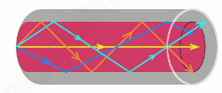
Multi mode fibers
If more than one mode is transmitted through optical fiber, then it is said to be a multimode fiber.
The larger core radius of multimode fibers make it easier to launch optical power into the fiber and facilitate the end to end connection of similar powers.
Figure 2.10 Multimode Optical Fiber [8]

Slide 30
Advantages of Multi- Mode Fiber
With a larger fiber core and good alignment tolerances
inexpensive
easy to couple light into Fiber
multimode fiber cable also provides high speed and high bandwidth over short distances.
multimode fiber cable is often used in data and audio/video applications in LANs.

Slide 31
Disadvantages of Multi-Mode Fiber
Multimode fiber cable has high dispersion and attenuation rate
The quality of optical signals is reduced as the transmission distance is getting longer.

Slide 32
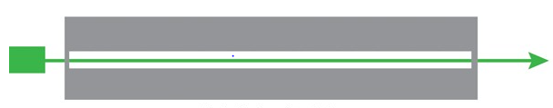
Step index fiber
In a step index fiber, the refractive index changes in a step fashion, from the centre of the fiber, the core, to the outer shell, the cladding.
It is high in the core and lower in the cladding. The light in the fiber propagates by bouncing back and forth from core-cladding interface.
Figure 2.11 Single mode step index [9]

Slide 33
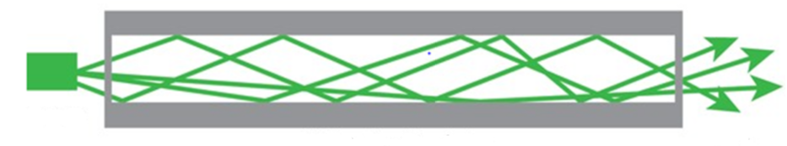
The step index fibers propagate both single and multimode signals within the fiber core.
The light rays propagating through it are in the form of meridinal rays which will cross the fiber core axis during every reflection at the core – cladding boundary and are propagating in a zig – zag manner.
Figure 2.12 Multimode Step index Fiber [9]

Slide 34
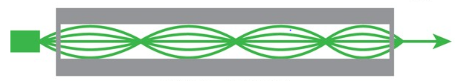
Graded index fiber
In graded index fibers, the refractive index of the core varies gradually as a function of radial distance from the fiber center.
The refractive index of the core decreases as we move away from the centre.
The refractive index of the core is made to vary in the form of parabolic manner such that the maximum refractive index is present at the centre of the core.
Figure 2.13 Graded Index Fiber [9]

Slide 35
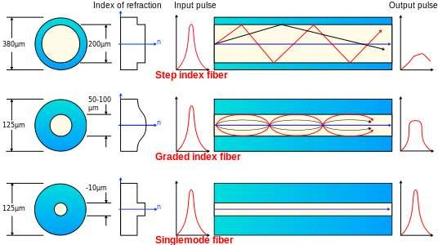
Summary of types of Fibers
Figure 2.14 Different types Of optical fibre [6]

Slide 36
Dispersion Types
The dispersion cause that optical pulses to broaden as they travel along a fiber, the overlap between neighboring pulses, creating errors in the receiver output, resulting in the limitation of information-carrying capacity of a fiber.
In communication, dispersion is used to describe any process by which any electromagnetic signal propagating in a physical medium is degraded because the various wave characteristics (i.e., frequencies) of the signal have different propagation velocities within the physical medium.
Types of Dispersion
Dispersion are of two types:
Intra modal or Chromatic Dispersion
Intermodal or Modal Dispersion

Slide 37
Intra modal or Chromatic Dispersion
Intramodal or Chromatic dispersion (CD) is caused by the fact that single mode glass fibers transmit light of different wavelengths at different speeds. The ratio of the speed of light in a medium to the speed in a vacuum defines the index of refraction or refractive index of the material.
Material Dispersion
This is due to intrinsic properties of the material, glass.
Glass is a dispersive medium. We can recall from our high school physics that glass has different refractive index for different colors.

Slide 38
Different colors (wavelengths) have different velocity in glass.
A type of dispersion that occurs in optical fiber due to the interaction of various wavelengths with the physical matter in the crystalline structure of the glass.
The refractive index of the glass varies according to the wavelength of the optical signal.
Material dispersion is the phenomena whereby materials cause a “bundle” of light to spread out as it propagates.

Slide 39
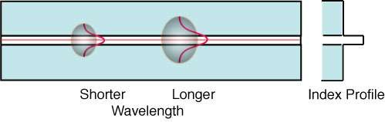
Waveguide Dispersion
This is due dispersive nature of the bound medium. In a bound medium like the optical fiber, the velocity is a function of frequency.
Figure 2.14 Waveguide dispersion [2]
Waveguide dispersion is chromatic dispersion which arises from waveguide effects: the dispersive phase shifts for a wave in a waveguide differ from those which the wave would experience in a homogeneous medium.

Slide 40
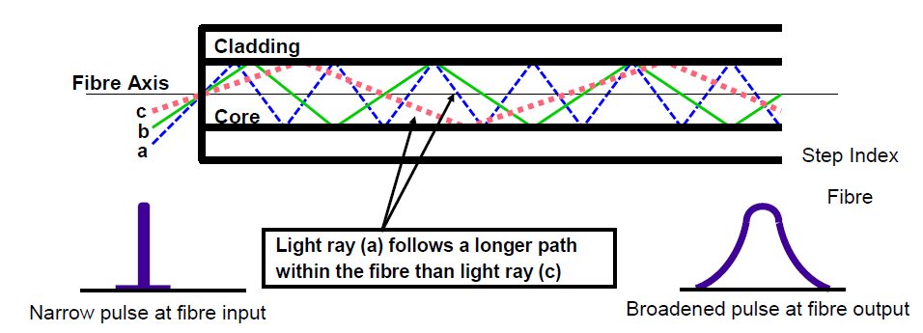
Intermodal or modal Dispersion
In a multimode fiber different modes travel at different velocities.
Figure 2.15 Modal Dispersion [2]

Slide 41
If a pulse is constituted from different modes then intermodal dispersion occurs.
Modal dispersion is greatest in multimode step index fibers.
The more modes the greater the modal dispersion.
Typical bandwidth of a step index fiber may be as low as 10 MHz over 1 km.
Attenuation in Optical Fibers
Attenuation limits the optical power which can reach the receiver, limiting the operating span of a system.
Once the power of an optical pulse is reduced to a point where the receiver is unable to detect the pulse, an error occurs.

Slide 42
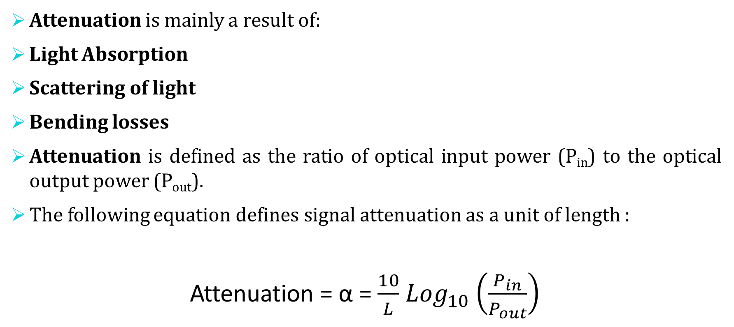
Attenuation is mainly a result of:
Light Absorption
Scattering of light
Bending losses
Attenuation is defined as the ratio of optical input power (P_{in}) to the optical output power (P_{out}).
The following equation defines signal attenuation as a unit of length :
Attenuation = α = $\frac{10}{L}$ ${Log}_{10}$ $\left(\frac{P_{in}}{P_{out}}\right)$

Slide 43
Types of Attenuation
Absorption Loss:
Caused by the fiber itself or by impurities in the fiber, such as water and metals.
Scattering Loss:
Intrinsic loss mechanism caused by the interaction of photons with the glass itself.
Bending loss:
Loss induced by physical stress on the fiber.

Slide 44
Material Absorption Losses
Material absorption is caused by absorption of photons within the fiber.
– When a material is illuminated, photons can make the valence electrons of an atom transition to higher energy levels
– Photon is destroyed, and the radiant energy is transformed into electric potential energy. This energy can then
Be re-emitted (scattering)
Frees the electron (photoelectric effects) (not in fibers)
Dissipated to the rest of the material (transformed into heat)
In an optical fiber Material Absorption is the optical power that is effectively
converted to heat dissipation within the fiber.
Two types of absorption exist:
– Intrinsic Absorption, caused by interaction with one or more of the components of the glass.
– Extrinsic Absorption, caused by impurities within the glass.

Slide 45
Intrinsic Absorption is caused by basic fiber material properties. If an optical fiber is absolutely pure, with no imperfections or impurities, ten all absorption will be intrinsic. Intrinsic absorption in the ultraviolet region is caused by electronic absorption bands. Intrinsic Absorption occurs when a light particle (photon) interacts with an electron and excites it to a higher energy level.
Extrinsic Absorption is caused by impurities caused by impurities introduced into the fiber material. The metal impurities such as iron, nickel and chromium are introduced into the fiber during fabrication. Extrinsic Absorption is caused by the electronic transition of these metal ions from one energy level to another energy level.

Slide 46
Fiber Bend Losses
Bending loss is classified according to the bend radius of curvature :
1. Microbend Loss 2. Macrobend Loss
Microbend Loss are caused by small discontinuities or imperfections in the fiber. Uneven coating applications and improper cabling procedure increases micro bend loss. External forces are also a source of micro bends.

Slide 47

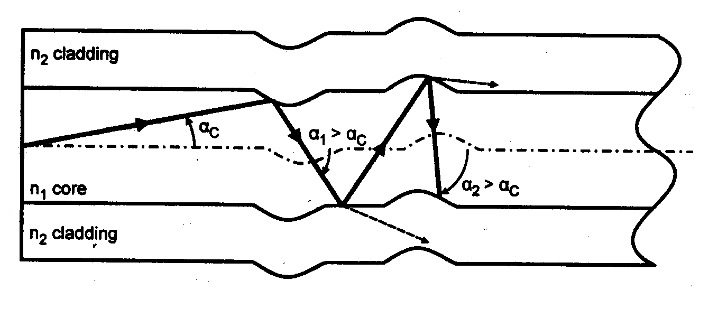

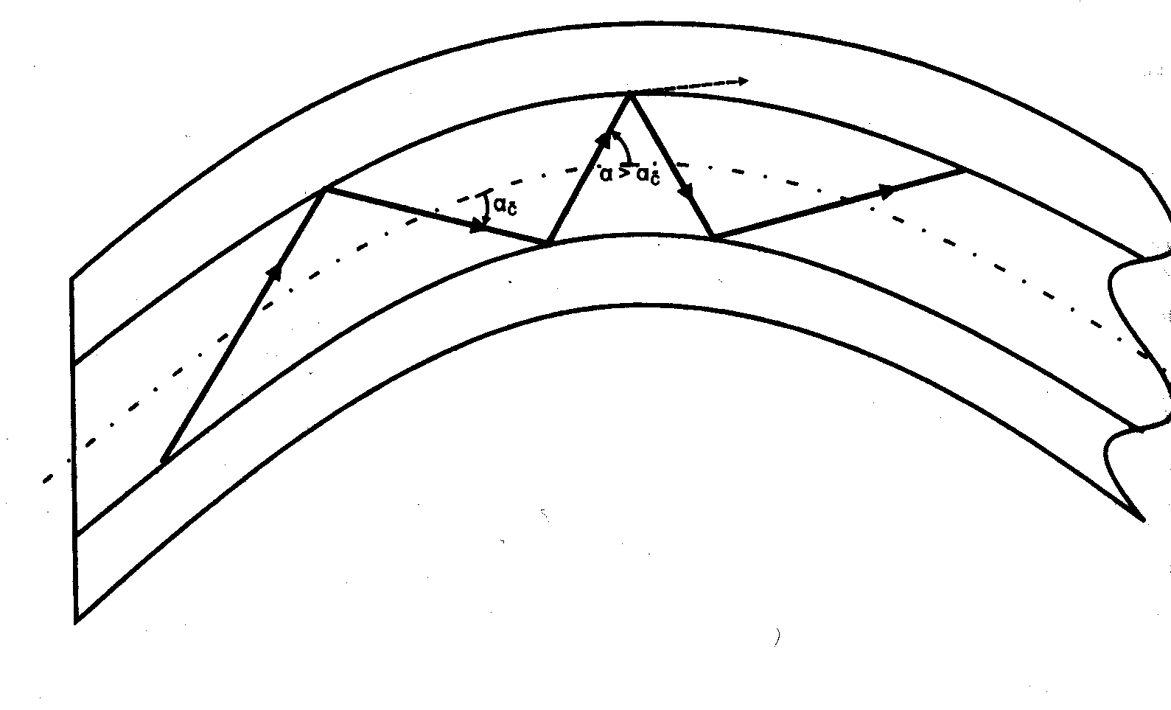
Macrobend Loss
Macrobend Losses are observed when a fiber bend’s radius of curvature is large compared to the fiber diameter. These bends are a great source of loss when the radius of curvature is less than several centimeters.
Figure 2.16 represent micro and macrobend in optical fiber [2]

Slide 48
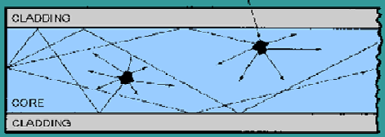
Linear Scattering Losses
Light scattering is a form of scattering in which light in the form of propagating energy is scattered.
Light scattering can be thought of as the deflection of a ray from a straight path, for example by irregularities in the propagation medium, particles, or in the interface between two media.
Deviations from the law of reflection due to irregularities on a surface are also usually considered to be a form of scattering.
When these irregularities are considered to be random and dense enough that their individual effects average out, this kind of scattered reflection is commonly referred to as diffuse reflection.
Figure 2.17 Light scattering [10]

Slide 49
Advantages of optical fiber communication
Increased Bandwidth and Channel Capacity
Low Signal Attenuation
Immune to Noise
No Crosstalk
Lower Bit Error Rates
Signal Security
Electrical Isolation
Reduced Size and Weight of Cables
Radiation Resistant and Environment Friendly
Resistant to Temperature Variations etc.

Slide 50
Disadvantages of optical fiber communication
Specialist skills needed
Cost of installation
Cost of transmission equipment from electrical to optical signals
Optical fibers can not carry electrical power

Slide 51
Applications of optical fiber communication
As fibers are very flexible, they are used in flexible digital cameras.
Fibers are used in mechanical imaging i.e. for inspection of mechanical welds in
pipes and engines of rockets, space shuttles, airplanes.
Fibers are used in medical imaging such as endoscopes and laparoscopes.
Fibers can be used under sea communication.
Fibers are used in military applications such as aircrafts, ships, tanks etc.

Slide 52
Nuclear testing applications use optical fiber phase sensors and transducers
Fibers are used in public utility organizations like railways, TV transmission etc.
Fibers are used in LAN systems of offices, industrial plants and colleges etc.
Fibers are used in telecommunication such as voice telephones, video phones, telegraph services, message services and data networks.

Slide 53
Summary
Brief Introduction
Optical fiber construction
Critical angle & Total Internal Reflection
Acceptance angle & acceptance cone
Numerical Aperture
V-Number
Types of fibers
Dispersion & its types
Attenuation and Losses in Fiber
Advantages
Disadvantages
Applications

Slide 54
Assessment Test
Quiz link for Assessment Test:-
https://docs.google.com/forms/d/e/1FAIpQLSdoaR30UPyyOY0IRVyChKPoZVB99BOTYyw61SPEVbYoxNepFQ/viewform?usp=pp_url
Home Assignment :-
Q.1 What are the advantages and disadvantages of fiber optic communications?
Mention the three advantages of optical fiber as waveguide over conventional metallic waveguide?

Slide 55
References
[1] https://www.ispreview.co.uk/index.php/2013/07/alcatel-lucent-breaks-record-with-31tbps-over-a-single-fibre-optic-cable.html
[2] http://constructionmanuals.tpub.com/14026/css/Fiber-Buffers-193.htm
[3] https://www.slideshare.net/ankushsaini123/6796optical-fibres
[4] https://www.slideshare.net/MadhumitaTamhane/optical-fiber-communication-part-1- optical-fiber-fundamentals
[5] (a) http://constructionmanuals.tpub.com/14026/css/Fiber-Buffers-193.htm
(b) https://computer.howstuffworks.com/fiber-optic2.htm
[6] https://www.slideshare.net/PratyushSrivastava8/optical-fiber-cable- v2?from_action=save
[7] https://www.ques10.com/p/21598/derive-the-expression-of-numerical-aperture- for-a-/
[8] https://www.explainthatstuff.com/fiberoptics.html
[9] http://fiberonda.com/single-mode-vs-multi-mode-fiber-optic-cable/
[10] https://images.app.goo.gl/LLWfgV3PjgLc9RbDA

Slide 56
Text book
Beiser A., Ghatak A, Garg S.C., Applied Physics, Edition 1st, (2013), Tata McGraw-Hill, Noida.
Laud B.B., Laser and Non -Linear Optics, Edition 1st, (1991), Wiley Eastern Ltd.
E- content
http://www.fiberopticshare.com/what-are-the-components-of-optical-fiber.html

Slide 57
THANK YOU
For Queries:-
deepak.e1972@cumail.in

